Slide 1

Health Checkup Data Analysis
Krupa Patel

Slide 2

AIM
To analyze health checkup data for 100,000 individuals
To identify key health metrics and demographic distributions
To provide insights for improving public health strategies

Slide 3
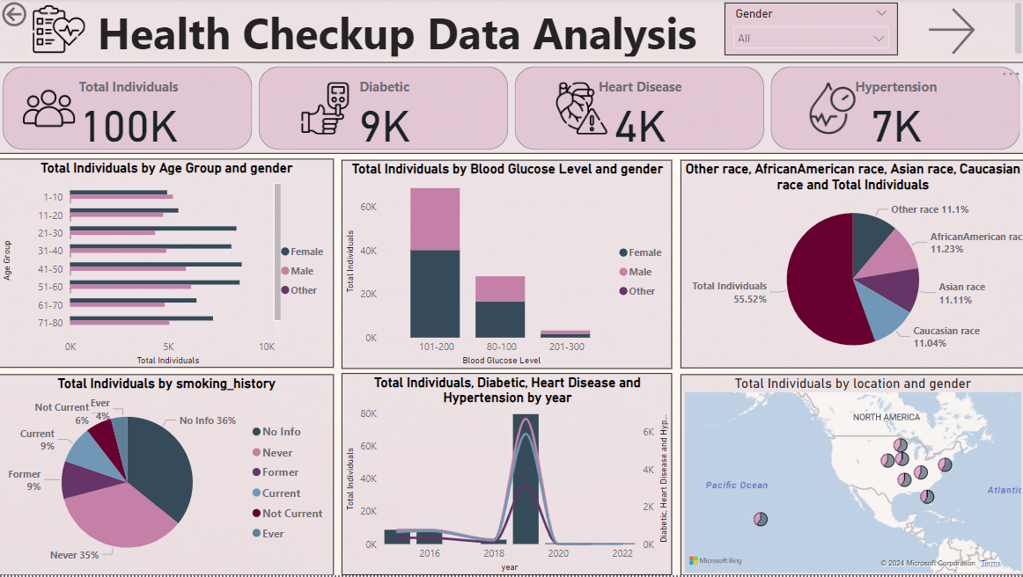

Slide 4

Key Points
Out of 100K,
9K individuals were found to be diabetic
4K individuals are having heart disease
7K are hyper tensed

Slide 5


By BGL & Gender
Out of 100K,
1742 females & 1535 males have sugar level more than 200 mg/dL, which is dangerous and a sign of diabetes, hypertension and heart diseases
It is observed that after age 50, the blood glucose level rises
What can we do about this?
Awareness Campaigns
Regular Screening
Diet Consultancy
Free Checkup Programmes

Slide 6

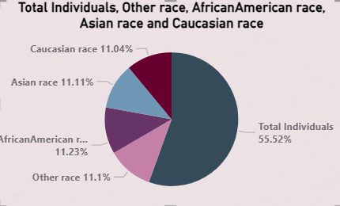
By Races
Caucasian-110.4
Asian-11.11%
AfricanAmerican-11.23%
Other-11.1%
Other-11.1%

Slide 7

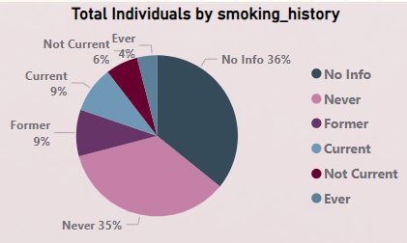
By Smoking
No Info-36%
Never-35%
Former-9%
Current-9%
Not Current-6%
Ever-4%
it is surprising that among diabetic people, most of are non-smokers and are female
Number of diabetic males who has a smoking history are higher than the females

Slide 8
Diagnosed by different types of medical conditions
Number of females having diabetes is more than number of males
After 50, cases of diabetes increased
Same trend is followed in the case of Hypertension
In case of heart disease, number of males is high
After 60, chances of having heart disease increases gradually
2019
Total Individuals | 100K
Diabetic | 6727
Hypertension | 5922
Heart Disease | 3150

Slide 9

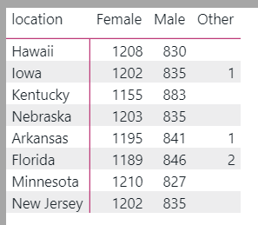

Geographical Analysis

Slide 10
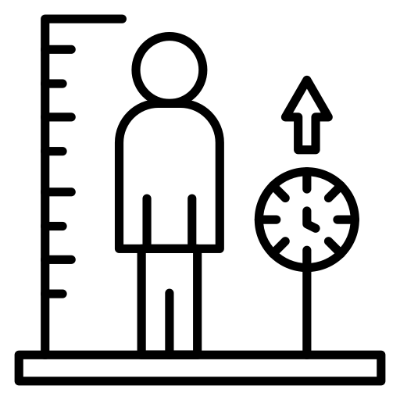
By BMI
BMI Group | Female | Male | Other
10-15 | 821 | 687 | 1
16-20 | 5006 | 3885 | 2
21-23 | 52725 | 36858 | 15
Uw: BMI < 18.5 | Ow: BMI 25–29.9
Nw: BMI 18.5–24.9 | Ob: BMI ≥ 30

Slide 11
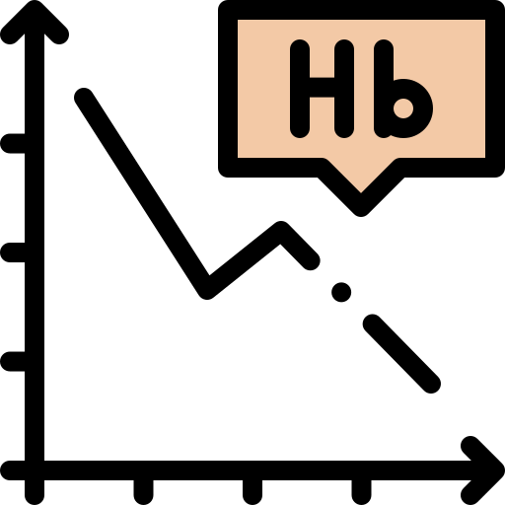
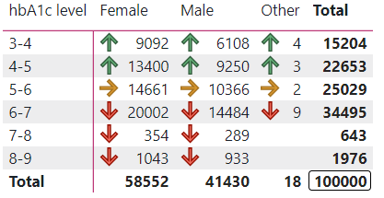
By hbA1c Level
Weight Management
Stress Management
Regular Exercise
Best suggestions

Slide 12


